Slide 1
Processes and problems
By Gorgeous

Slide 2
Flow Diagram
First stage
Compare with Common Design
second stage
Detail compare with Common Design
third stage
Replace all of components
Target:
1.Schematic compare
2.Simple components compare.
3. Quantity check
4.List special case for optional items
Target:
1.Completely first stage for optional items
Target:
1.Replace all of components

Slide 3
First stage: Compare with Common Design
There is show out an error if different with the rule
Tool compare real rule :
Capture one of page with same IC , compare the Manufacturer and Manufacturer Part Number.
If the IC is the same one , then compare the Pin quantity and routing path.
Comparing the detail information with the same Pin routing , which is comparing Manufacturer and Manufacturer Part Number of the components on the path.
Notice: Need to follow the below items , then that will be get error.
The page Numbers need to map with original .DSN file
There are the same component quantity by each page.
SIM will share the different pin definition of more 3 Pin components(Reference attached) then User need update the related of Pin mapping

Slide 4
Compare Rule :
Schematic compare ：
Path by Path to compare
Check all of component’s pin out by each Pin ,then compare with common circuit quantity , list fail component’s page and type.
Component compare ：
Compare all components with Common design about “ Vendor PN , Vendor and SSID “ (FXN :Mfg part number , Mfg and sub system )
Provide BOM ( check items of Manufacturer and Manufacturer Part Number ) and DSN to compare
Ex: from U1 Pin1 to U2 Pin
Path >> U1 Pin 1 → trace 1 →R1 →trace 2 →R2 →trace 3 →U2
U1 Pin 1 → trace 1 →R1 →trace 2 →C1 →trace 4 →GND(PWR)
1
Trace1
Trace2
Trace3
8
R1
R2
1
8
7
U1
2
2
7
6
3
3
U2
6
5
4
C1
4
5
Trace4

Slide 5
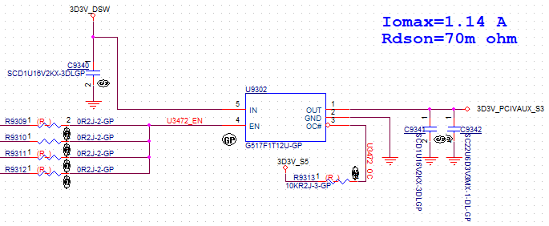
Question:
How to check the component Pin out or name is correct or not ?(3Pin or more than 3 Pin)→move to second stage to add this function , under check how to compare.
Power net name rule →wait for Customer update
The filter capacitor between DC power and ground cannot be read. → Wait to check the new method can be point out the fail page and type or not
update

